Slide 1
DESAFÍO CLASIFICACIÓN DE CLIMAS EN EL AEROPUERTO ADOLFO SUÁREZ MADRID-BARAJAS
Integrantes:
Cubric, Walter
Flores, Román
Giusti, Patricio Daniel
Tovar, Alan
Tovar, Franco

Slide 2
OBJETIVO
Desarrollar un modelo que pronostique los eventos climatológicos en el Aeropuerto Adolfo Suarez Madrid - Barajas.

Slide 3
ANALISIS
¿Qué elementos son necesarios para pronosticar el Clima?
¿Nuestro Dataset tiene esa información?
Temperatura
Precipitaciones
Humedad
Presión atmosférica
Vientos
✓
✓
✓
✓
✓

Slide 4
BASE DE DATOS

Slide 5
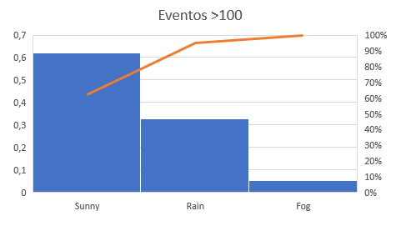
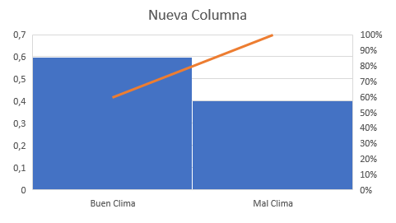
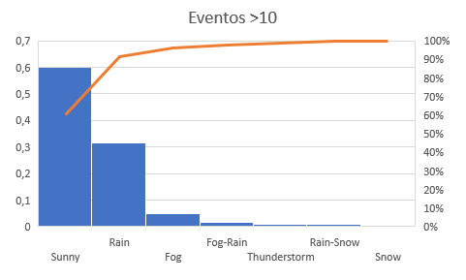
BASE DE DATOS
DEFINICION DE DATASET EN BASE A OBSERVACIONES

Slide 6
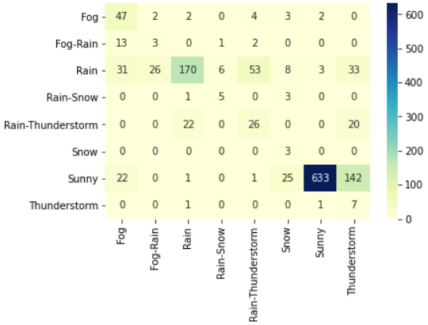
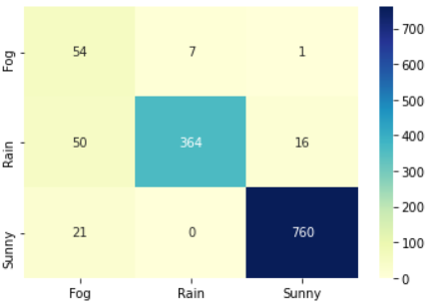
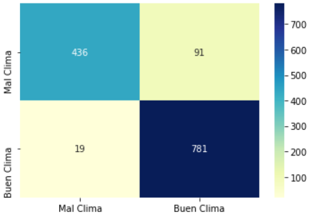
RESULTADOS NAIVE BAYES
>10
 | precision | recall | f1-score
accuracy |  |  | 0.68
macro avg | 0.40 | 0.62 | 0.40
weighted avg | 0.87 | 0.68 | 0.75
>100
 | precision | recall | f1-score
accuracy |  |  | 0.93
macro avg | 0.80 | 0.90 | 0.82
weighted avg | 0.95 | 0.93 | 0.93
Columna nueva
 | precision | recall | f1-score
accuracy |  |  | 0.92
macro avg | 0.93 | 0.90 | 0.91
weighted avg | 0.92 | 0.92 | 0.92

Slide 7
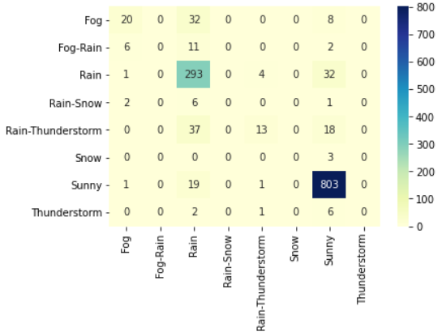
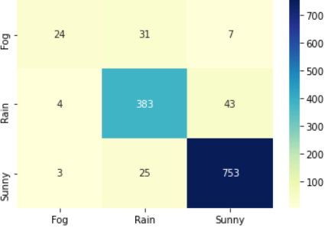
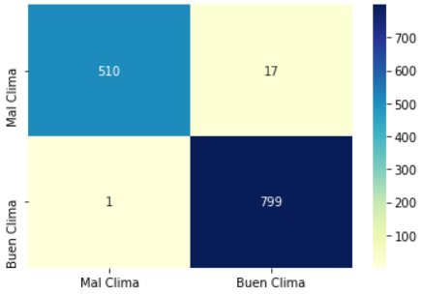
RESULTADOS REGRESIÓN LOGÍSTICA
>10
 | precision | recall | f1-score
accuracy |  |  | 0.85
macro avg | 0.38 | 0.30 | 0.31
weighted avg | 0.82 | 0.85 | 0.83
>100
 | precision | recall | f1-score
accuracy |  |  | 0.91
macro avg | 0.86 | 0.75 | 0.78
weighted avg | 0.91 | 0.91 | 0.91
 | Columna nueva
 | precision | recall | f1-score
accuracy |  |  | 0.99
macro avg | 0.99 | 0.98 | 0.99
weighted avg | 0.99 | 0.99 | 0.99

Slide 8
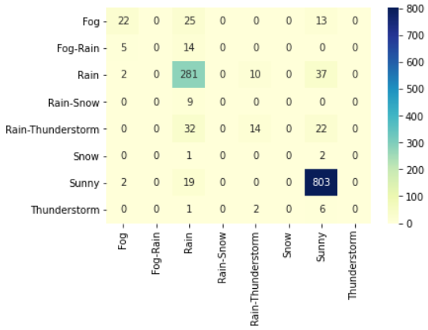
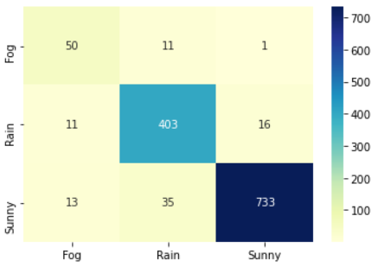
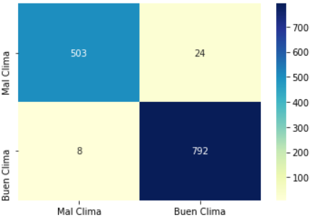
RESULTADOS REGRESIÓN LOGÍSTICA
(PCA + GRID)
>10
 | precision | recall | f1-score
accuracy |  |  | 0.85
macro avg | 0.36 | 0.30 | 0.31
weighted avg | 0.81 | 0.85 | 0.82
>100
 | precision | recall | f1-score
accuracy |  |  | 0,93
macro avg | 0,85 | 0,89 | 0,87
weighted avg | 0,94 | 0,93 | 0,93
Columna nueva
 | precision | recall | f1-score
accuracy |  |  | 0,98
macro avg | 0,98 | 0,97 | 0,97
weighted avg | 0,98 | 0,98 | 0,98

Slide 9
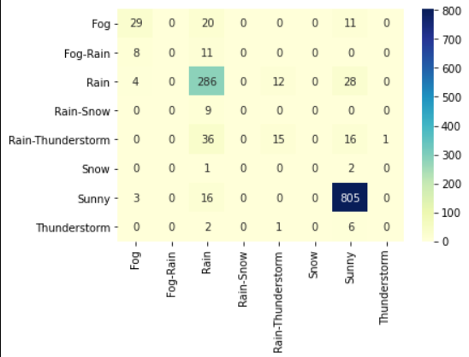
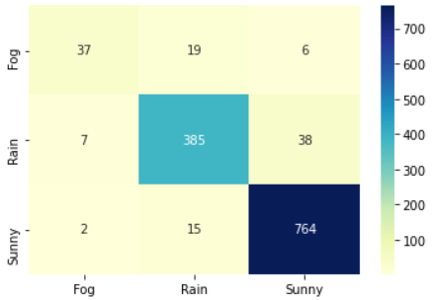
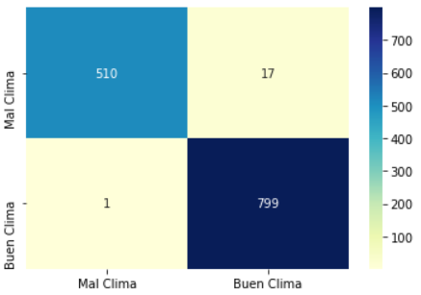
RESULTADOS KNN
>10
 | precision | recall | f1-score
accuracy |  |  | 0,86
macro avg | 0,36 | 0,32 | 0,33
weighted avg | 0,82 | 0,86 | 0,84
>100
 | precision | recall | f1-score
accuracy |  |  | 0,93
macro avg | 0,89 | 0,82 | 0,85
weighted avg | 0,93 | 0,93 | 0,93
Columna nueva
 | precision | recall | f1-score
accuracy |  |  | 0,99
macro avg | 0,99 | 0,98 | 0,99
weighted avg | 0,99 | 0,99 | 0,99

Slide 10
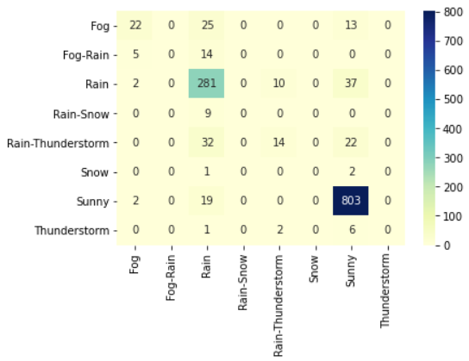
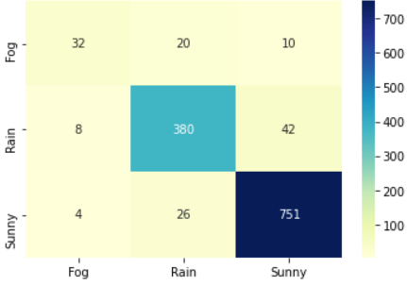
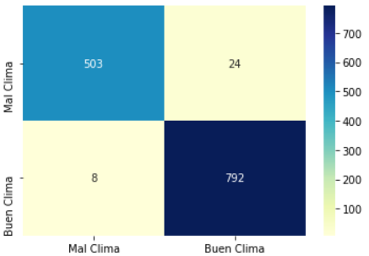
RESULTADOS KNN (PCA + GRID)
>10
 | precision | recall | f1-score
accuracy |  |  | 0,85
macro avg | 0,36 | 0,3 | 0,31
weighted avg | 0,81 | 0,85 | 0,82
>100
 | precision | recall | f1-score
accuracy |  |  | 0,91
macro avg | 0,85 | 0,79 | 0,81
weighted avg | 0,91 | 0,91 | 0,91
Columna nueva
 | precision | recall | f1-score
accuracy |  |  | 0,98
macro avg | 0,98 | 0,97 | 0,97
weighted avg | 0,98 | 0,98 | 0,98

Slide 11
RESULTADOS COMPARATIVA
>10 RL |  |  |  |  | >100 RL + Grid + PCA |  |  |  |  |  | Columna nueva RL
 | precision | recall | f1-score |  |  | precision | recall | f1-score |  |  | precision | recall | f1-score
accuracy |  |  | 0,85 |  | accuracy |  |  | 0,93 |  | accuracy |  |  | 0,99
macro avg | 0,38 | 0,3 | 0,31 |  | macro avg | 0,85 | 0,89 | 0,87 |  | macro avg | 0,99 | 0,98 | 0,99
weighted avg | 0,82 | 0,85 | 0,83 |  | weighted avg | 0,94 | 0,93 | 0,93 |  | weighted avg | 0,99 | 0,99 | 0,99
>10 KNN |  |  |  |  | >100 KNN |  |  |  |  | Columna nueva KNN
 | precision | recall | f1-score |  |  | precision | recall | f1-score |  |  | precision | recall | f1-score
accuracy |  |  | 0,86 |  | accuracy |  |  | 0,93 |  | accuracy |  |  | 0,99
macro avg | 0,36 | 0,32 | 0,33 |  | macro avg | 0,89 | 0,82 | 0,85 |  | macro avg | 0,99 | 0,98 | 0,99
weighted avg | 0,82 | 0,86 | 0,84 |  | weighted avg | 0,93 | 0,93 | 0,93 |  | weighted avg | 0,99 | 0,99 | 0,99
>10 NB |  |  |  |  | >100 NB |  |  |  |  | Columna nueva NB
 | precision | recall | f1-score |  |  | precision | recall | f1-score |  |  | precision | recall | f1-score
accuracy |  |  | 0.68 |  | accuracy |  |  | 0.93 |  | accuracy |  |  | 0.92
macro avg | 0.40 | 0.62 | 0.40 |  | macro avg | 0.80 | 0.90 | 0.82 |  | macro avg | 0.93 | 0.90 | 0.91
weighted avg | 0.87 | 0.68 | 0.75 |  | weighted avg | 0.95 | 0.93 | 0.93 |  | weighted avg | 0.92 | 0.92 | 0.92

Slide 12
CONCLUSIONES
El score de los diferentes modelos aumenta a medida que se concentran los datos
El macro AVG (promedio) disminuye considerablemente al tener pocas observaciones en alguna predicción, al modelo se le es imposible de clasificar correctamente.
La combinación de PCA con Grid Search no siempre mejora el score del modelo pero aumenta la velocidad del calculo computacional
Hemos probado si Desision tree Classifier en combinación con Grid Search, les compartimos los resultados

Slide 13
BONUS RESULTADOS COMPARATIVA
>10 RL |  |  |  |  | >100 RL + Grid + PCA |  |  |  |  |  | Columna nueva RL
 | precision | recall | f1-score |  |  | precision | recall | f1-score |  |  | precision | recall | f1-score
accuracy |  |  | 0,85 |  | accuracy |  |  | 0,93 |  | accuracy |  |  | 0,99
macro avg | 0,38 | 0,3 | 0,31 |  | macro avg | 0,85 | 0,89 | 0,87 |  | macro avg | 0,99 | 0,98 | 0,99
weighted avg | 0,82 | 0,85 | 0,83 |  | weighted avg | 0,94 | 0,93 | 0,93 |  | weighted avg | 0,99 | 0,99 | 0,99
>10 KNN |  |  |  |  | >100 KNN |  |  |  |  | Columna nueva KNN
 | precision | recall | f1-score |  |  | precision | recall | f1-score |  |  | precision | recall | f1-score
accuracy |  |  | 0,86 |  | accuracy |  |  | 0,93 |  | accuracy |  |  | 0,99
macro avg | 0,36 | 0,32 | 0,33 |  | macro avg | 0,89 | 0,82 | 0,85 |  | macro avg | 0,99 | 0,98 | 0,99
weighted avg | 0,82 | 0,86 | 0,84 |  | weighted avg | 0,93 | 0,93 | 0,93 |  | weighted avg | 0,99 | 0,99 | 0,99
>10 NB |  |  |  |  | >100 NB |  |  |  |  | Columna nueva NB
 | precision | recall | f1-score |  |  | precision | recall | f1-score |  |  | precision | recall | f1-score
accuracy |  |  | 0.68 |  | accuracy |  |  | 0.93 |  | accuracy |  |  | 0.92
macro avg | 0.40 | 0.62 | 0.40 |  | macro avg | 0.80 | 0.90 | 0.82 |  | macro avg | 0.93 | 0.90 | 0.91
weighted avg | 0.87 | 0.68 | 0.75 |  | weighted avg | 0.95 | 0.93 | 0.93 |  | weighted avg | 0.92 | 0.92 | 0.92
>10 DTC |  |  |  |  | >100 DTC |  |  |  |  | Columna nueva DTC
 | precision | recall | f1-score |  |  | precision | recall | f1-score |  |  | precision | recall | f1-score
accuracy |  |  | 0.90 |  | accuracy |  |  | 0.97 |  | accuracy |  |  | 0.99
macro avg | 0.66 | 0.59 | 0.57 |  | macro avg | 0.90 | 0.91 | 0.91 |  | macro avg | 0.99 | 0.99 | 0.99
weighted avg | 0.89 | 0.90 | 0.89 |  | weighted avg | 0.97 | 0.97 | 0.97 |  | weighted avg | 0.99 | 0.99 | 0.99

